Slide 1
Azure VM
An Azure Virtual Machine (VM) is a scalable computing resource offered by Microsoft Azure, designed to provide on-demand, cloud-based computing power.

Slide 2
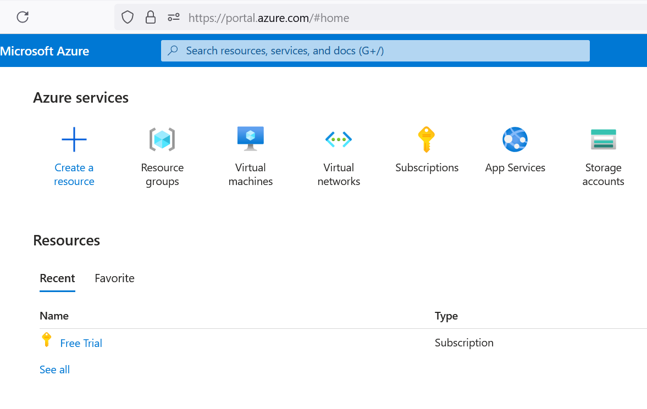

Slide 3
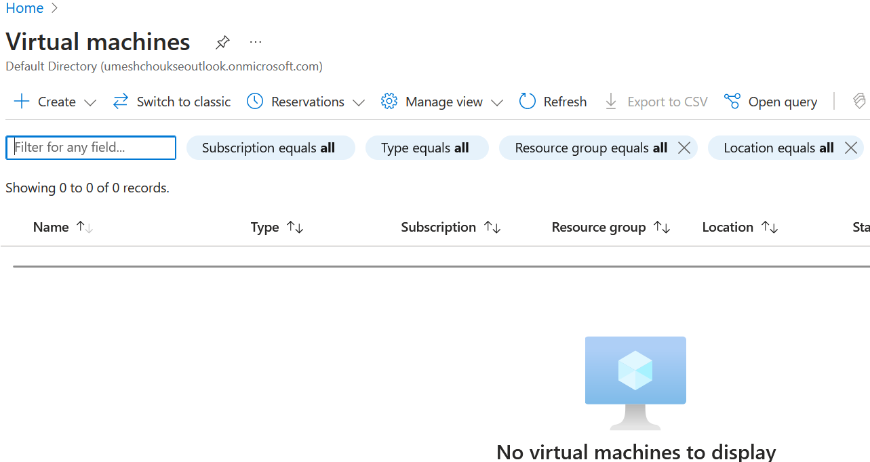

Slide 4
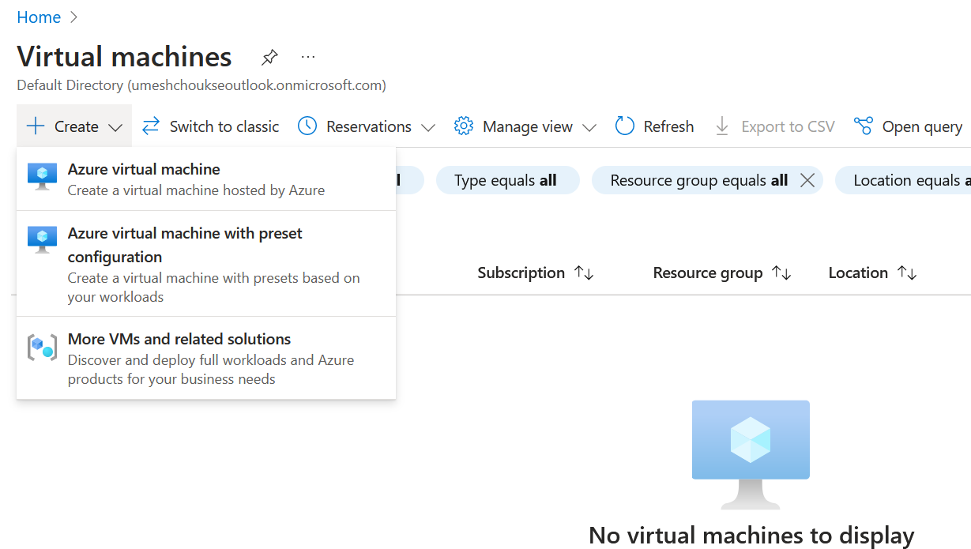

Slide 5
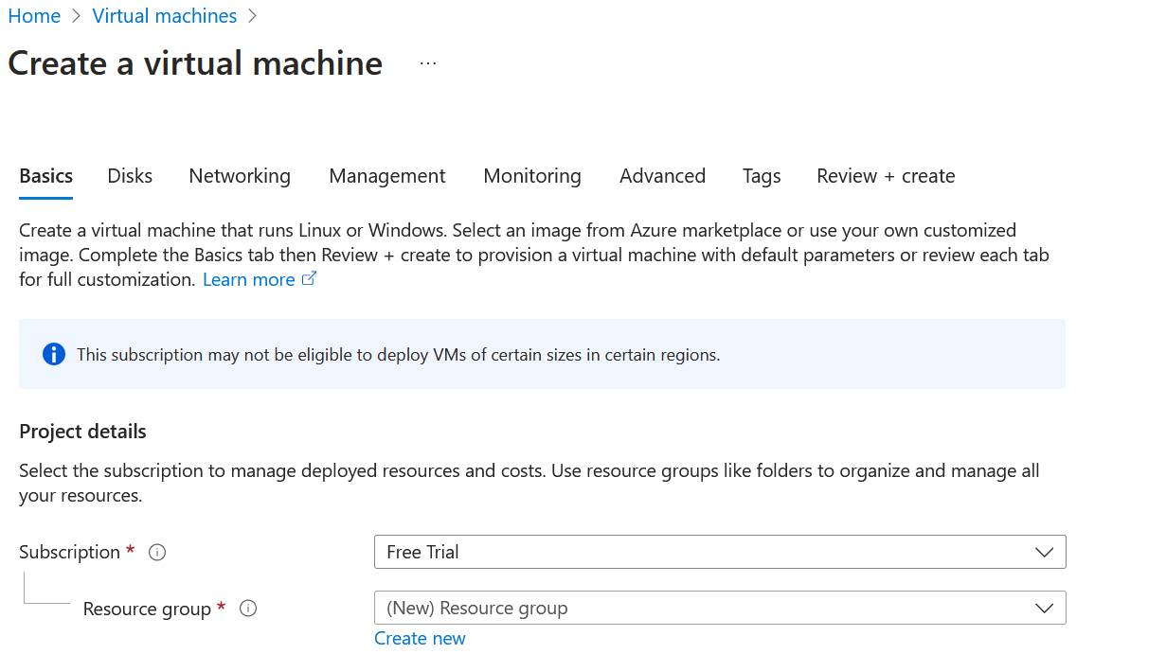

Slide 6
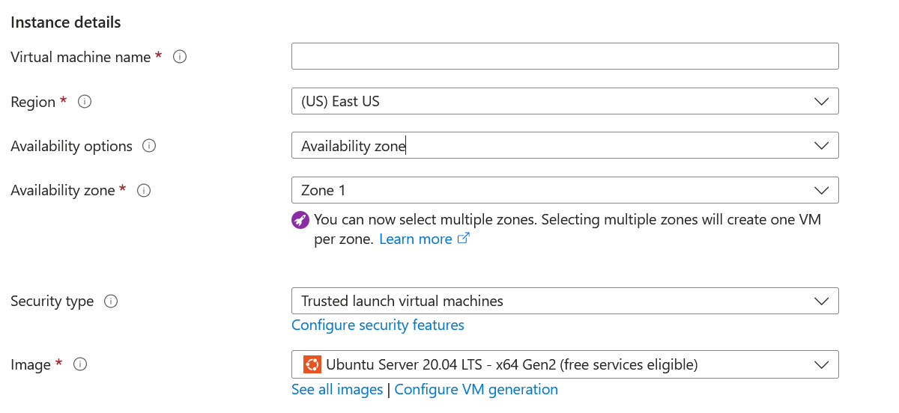

Slide 7
Trusted launch VM
Trusted Launch for Azure Virtual Machines is a security feature designed to enhance the security posture of VMs by providing improved protection against advanced threats. Trusted Launch builds upon the existing security features in Azure and incorporates additional layers of security to safeguard the integrity and confidentiality of VM workloads.

Slide 8
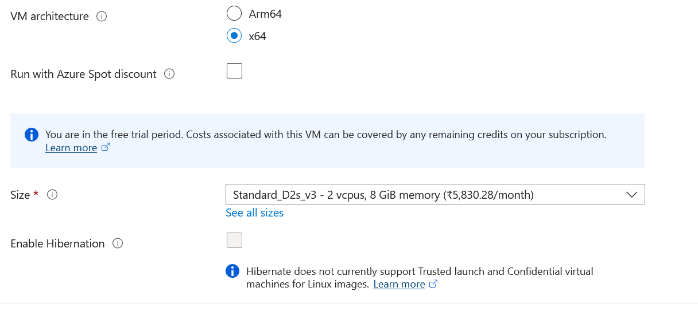

Slide 9
VM architecture
x64 (x86-64)
x64, also known as x86-64, is the 64-bit extension of the x86 architecture. It was developed by AMD (initially called AMD64) and later adopted by Intel (as Intel 64). x64 processors are dominant in desktop, laptop, and server markets.
ARM64 (AArch64)
ARM64, also known as AArch64, refers to the 64-bit architecture of the ARM family of processors. ARM (Advanced RISC Machine) processors are known for their energy efficiency and are widely used in mobile devices, embedded systems, and increasingly in servers and desktops.

Slide 10
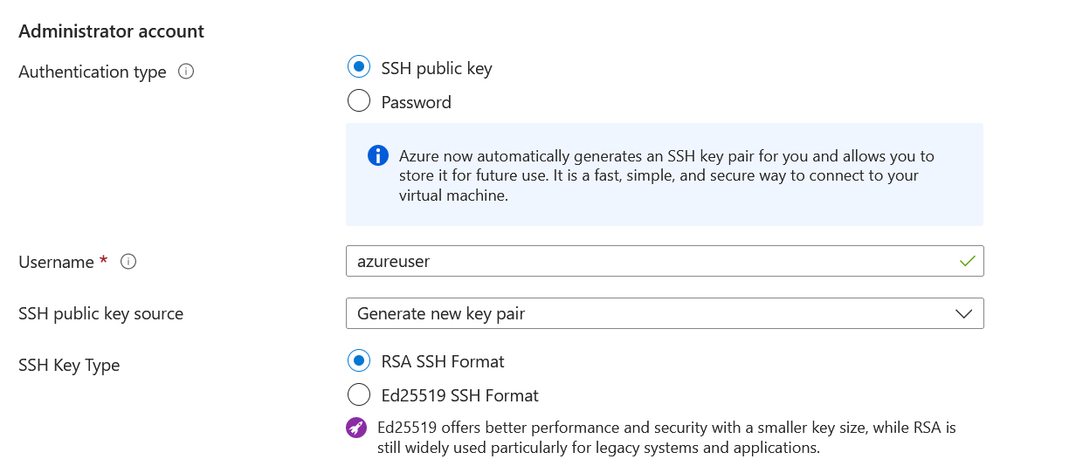

Slide 11
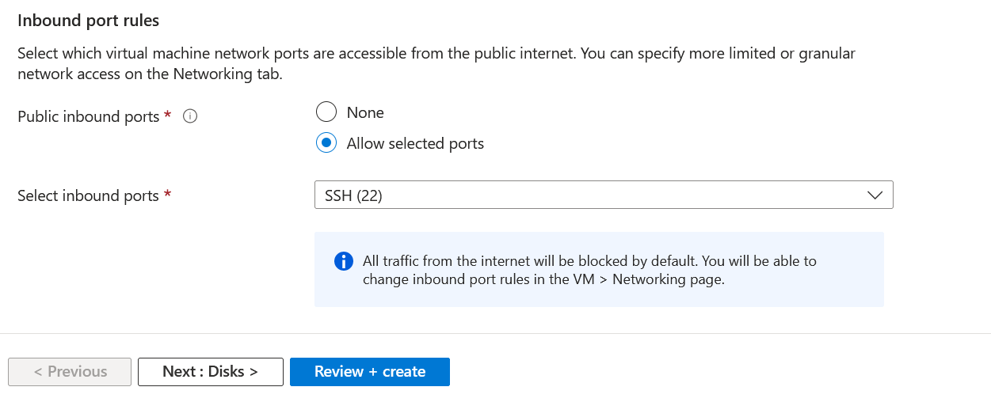

Slide 12
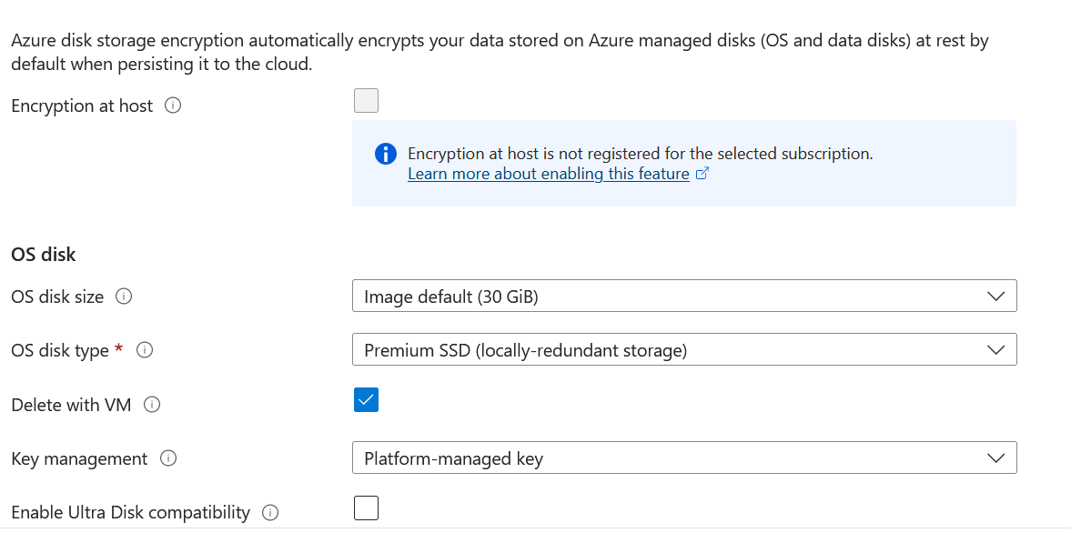

Slide 13
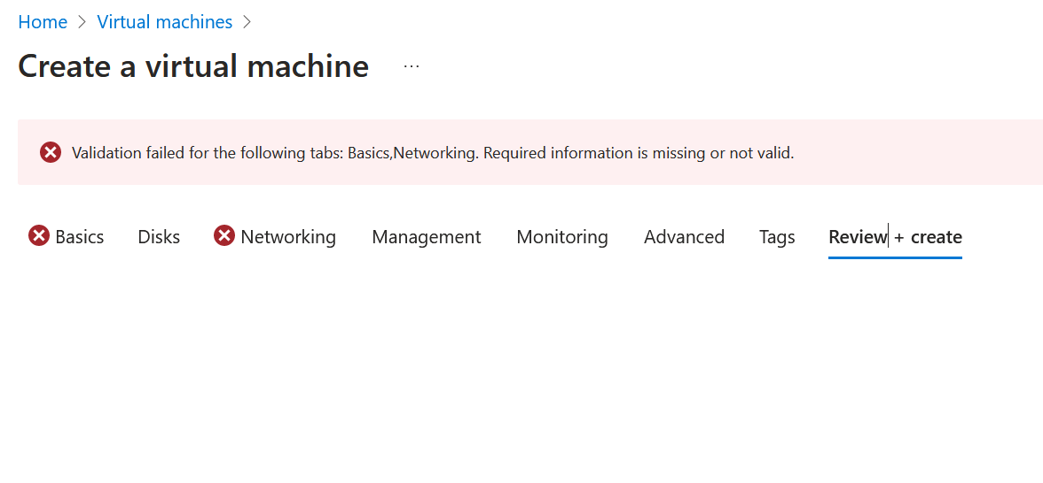

Slide 14
Support link
https://azure.microsoft.com/en-in/products/virtual-machines

